Slide 1
What's the Average Customer Profile
$13,270 Average Rate
30.6 Average BMI
39 years Average Age
The profile represents the distribution of customers out of 1,338 sample

Slide 2
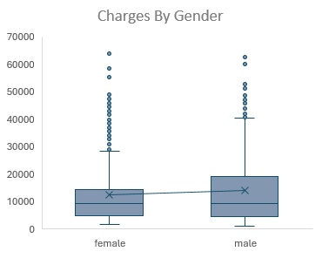
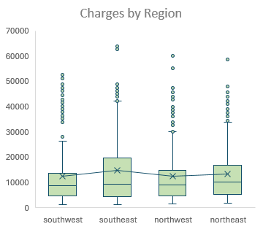
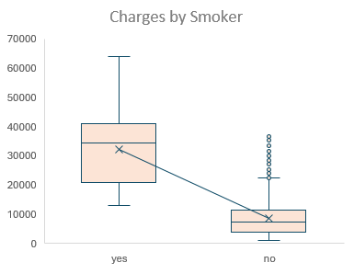
What categories Have the Highest Charges?
Categories and Charges:
Average Smoker Rates are 4x higher.
Average Male charge for males 10% higher.
Southeast has the highest average is 14.7k/

Slide 3
Relationship with charges What’s correlated with increased charges.
.29
.19
The relationship between variables
We can see that in the data the age and BMI increases so does the insurance charges.
There are other variables in our data that may have similar or opposite effect.

Slide 4
What drives insurance rates upward? We can use regression to move from correlation to causation
Linear regression was used to help explain increases in insurance rates based on the dimensions. These were significant .05 p-value

Slide 5
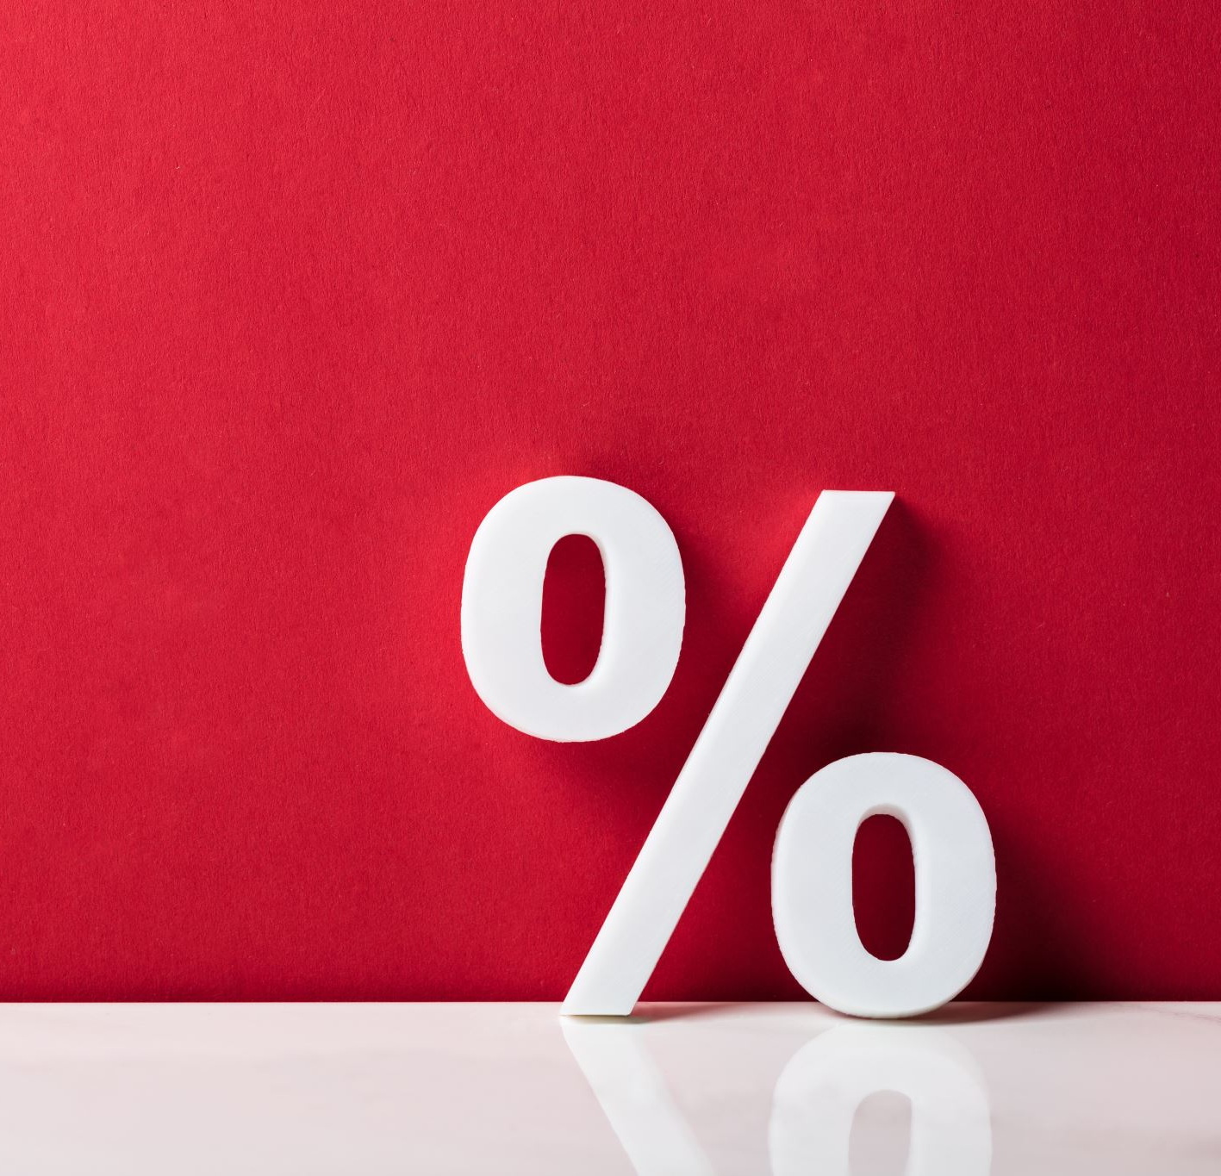
Summary & Recommendations
Summary:
Although. there are many factors that correlate with both increases
and decreases in insurance rates
The most Significant factors that chance insurances rates are:
Smoking ($23k)
# Children($475)
Increases in BMI($339)
Advancing Age ($256)
%Per on Unit Increase
Although there are combination of factors that increases rates, agents can use these factors to discuss and to give a very general estimate on increases to overall rates. Alternatively, we can use these values to create a prediction formula for agents to use after inputting the specifics.

